Slide 1
New Roots for Restoration
Hamad Khan, Alexander Juan, Julia Pratt
Supervisor: Dr. Abby Stylianou

Slide 2
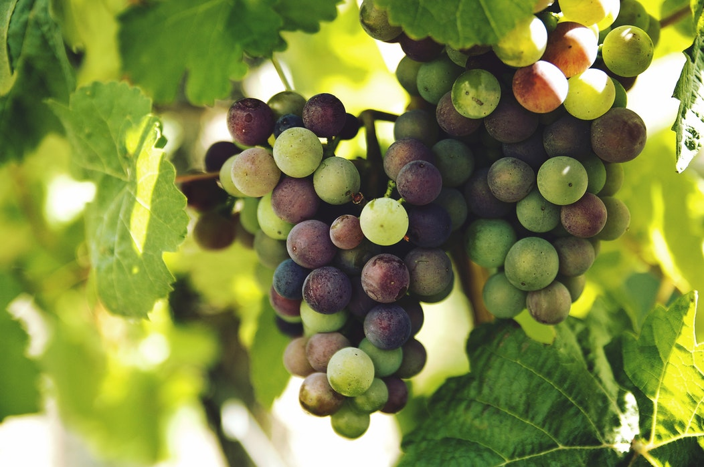
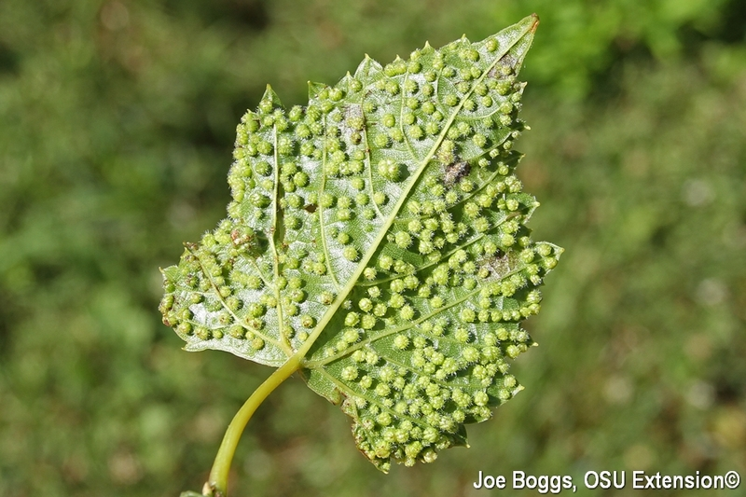
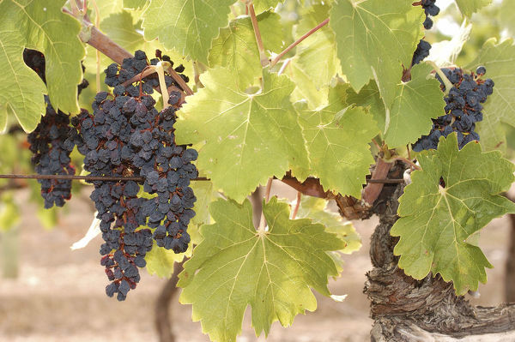
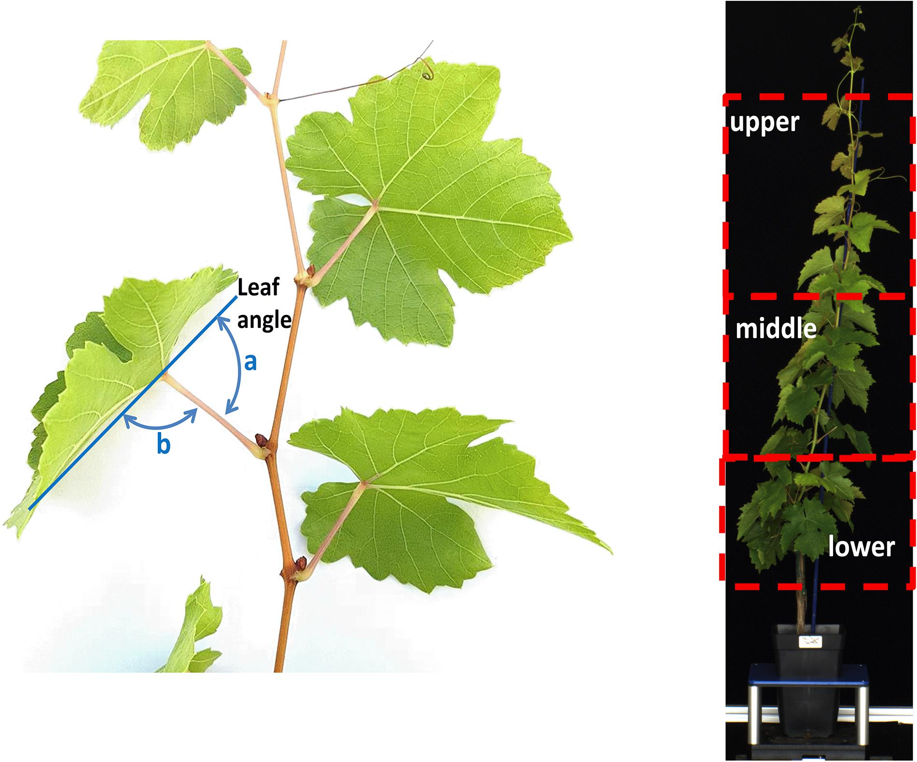
Overview of Project
https://bygl.osu.edu/node/400
In plant biology an important task is making measurements in the field of physical properties of the plants - this is called “phenotyping”
Plant height, number of leaves, leaf angle, whether the plant is exhibiting plant stress, etc
https://mywinedays.com/veraison-grapevine-life-cycle-wine-winepassport
https://www.mediastorehouse.com/auscape/biosphoto-collection/grapes-vitis-vinifera-15470746.html
https://www.frontiersin.org/articles/10.3389/fpls.2020.00595/full
Notes:
Alex

Slide 3
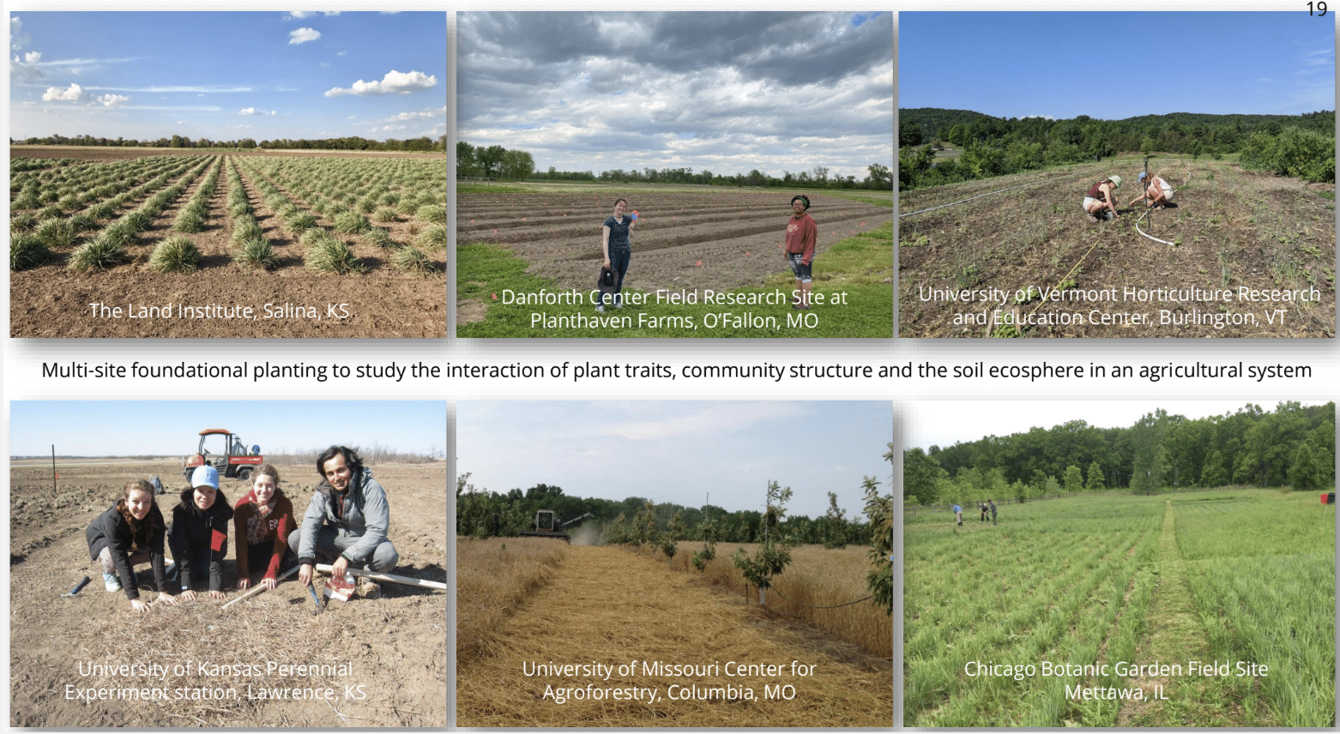
Overview of Project
Problem: field measurements are difficult to organize - there is no standardization.
Many field observations are scribbled down in notebooks making them difficult to analyze
Notes:
Alex

Slide 4
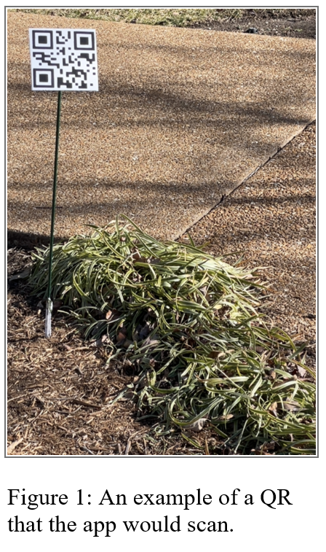
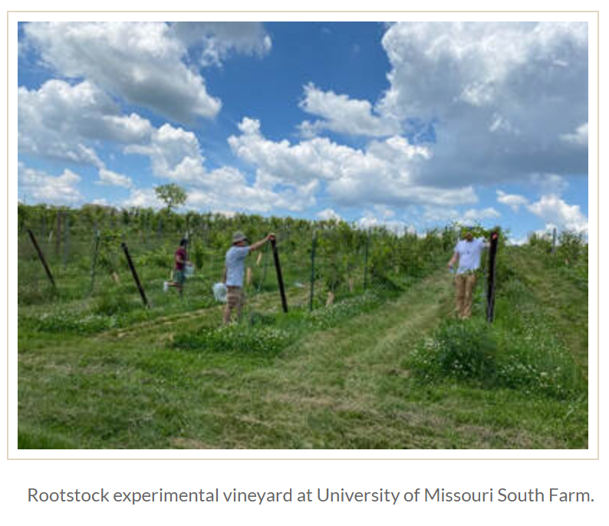
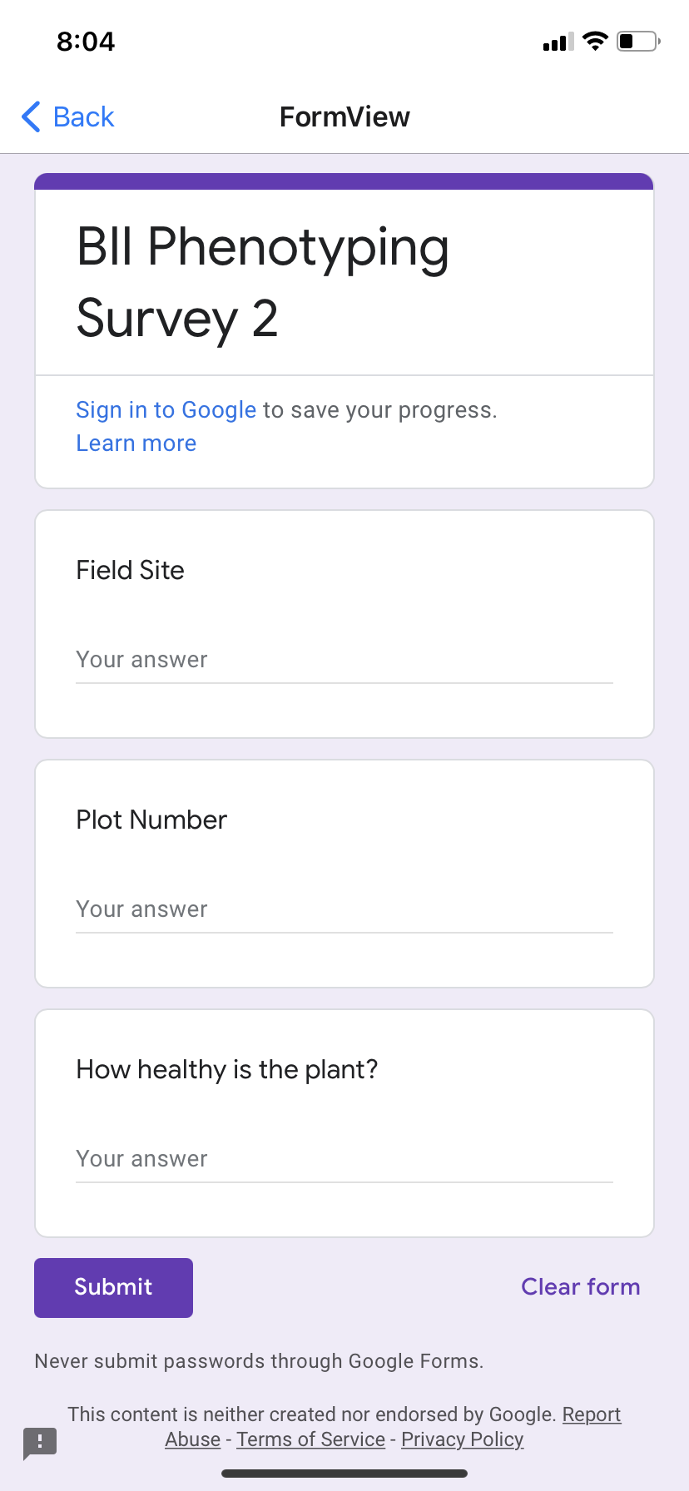
Overview of Project
Goal: Design an application that streamlines this process and assists with data storage & access
We can assume most research sites are divided into rectangular row x column plots of plants
Notes:
Alex

Slide 5
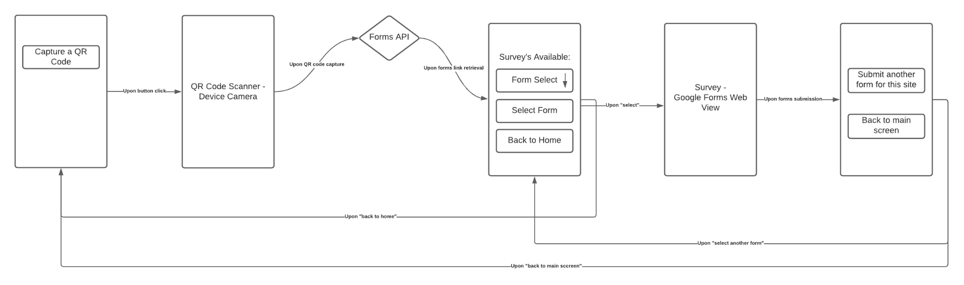
First Wireframe
Notes:
Julia

Slide 6
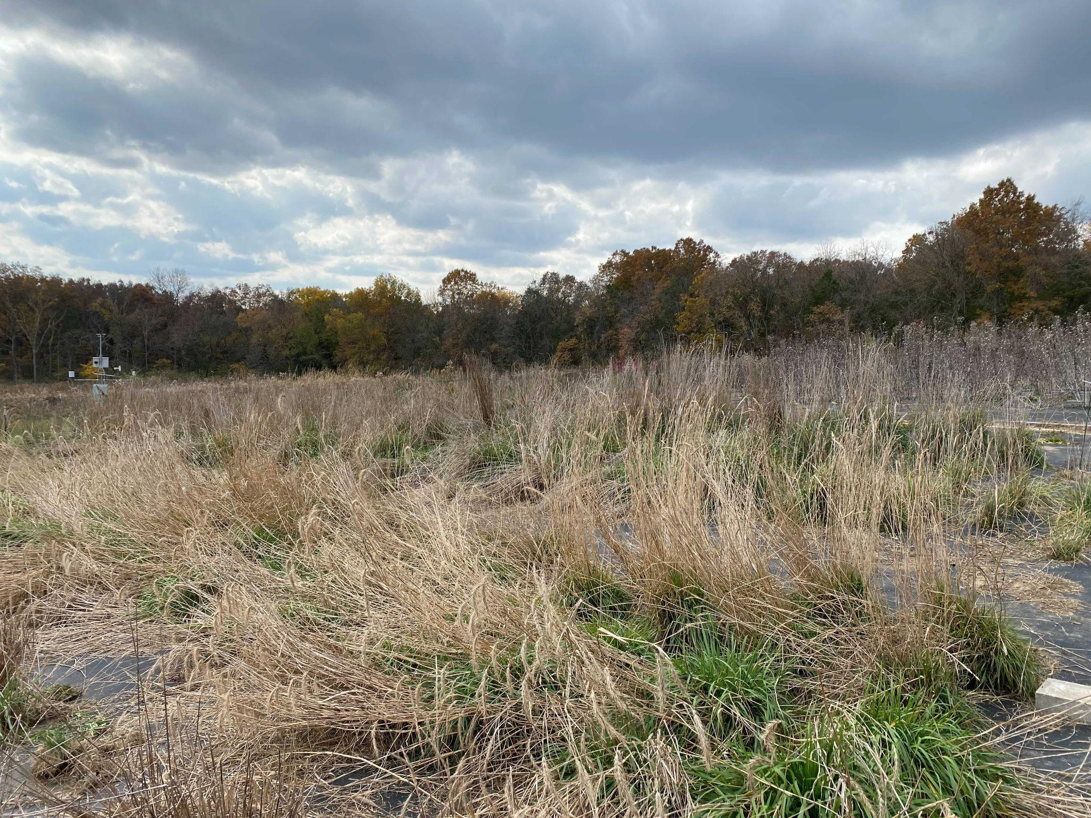
An iterative
process…
Notes:
Julia

Slide 7
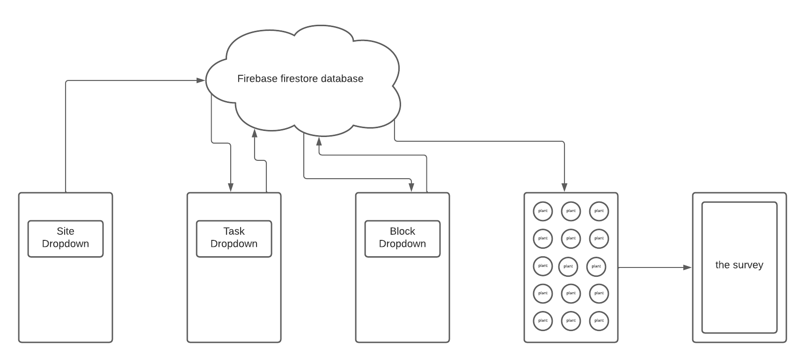
Newest Wireframe

Slide 8
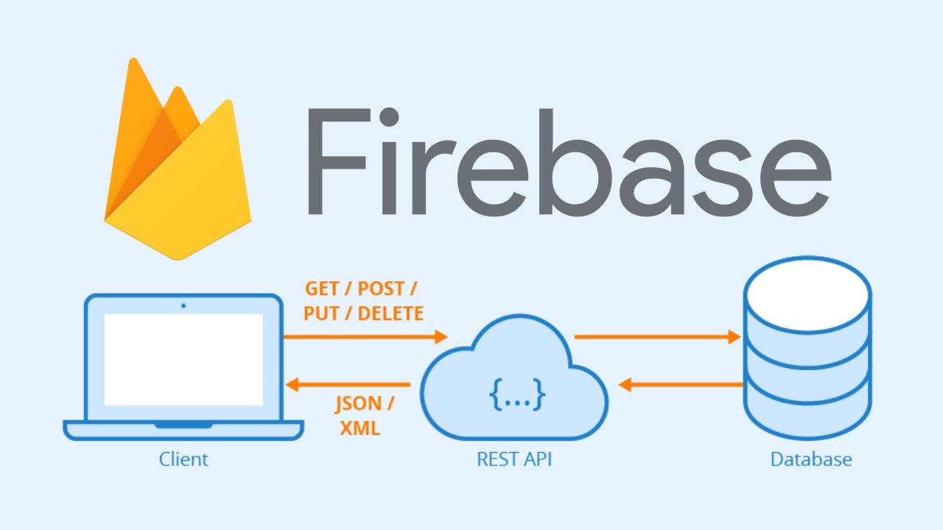
1. New Database System! (Again)
Notes:
Julia

Slide 9
Firebase Realtime Database vs Firebase Firestore
Realtime Database
Firestore
- serverless SDK
- realtime updates
- free
Primarily synchronizing data, basic querying
A few GBs of less of data that changes frequently
A simple JSON tree of data
99.95% uptime
Unable to perform offline queries
Advanced querying, sorting, and transactions
Hundreds of GBs to TBs of data that is frequently read (and changed less frequently)
Documents organized into collections
99.999% uptime guarantee
Perform queries with limited or no queries
Many databases

Slide 10

Video of Application
Notes:
Alex

Slide 11
Deliverable 4… finishing up.
Dynamically represent plant status (surveyed or not surveyed)
Test with researchers and continue to iterate on feedback
Deploy

Slide 12
New Deliverables
Deliverable 1
Deliverable 2
Deliverable 3
Deliverable 4
Decide on survey method
Decide database
Choose framework
Wireframes (drawn and basic page implementation)
Design new firebase database
Connect firebase database to application
Dynamically load field sites and tasks
Implement new plant-select view
Implement new screen format
Preliminary working version of the app
Ability for researchers to update database with new sites, tasks, and forms
Dynamically load correct forms link based on user feedback
Prefill Google forms with necessary information
Iterate on user feedback
Bug-free fully functional application
Change the color of the plant circles based on whether it's alive and whether it's had a survey filled for it previously.
Notes:
Hamad Khan

